Slide 1
Loss Function
Achilleas Tsakpinis
02.12.2022

Slide 2
Use of loss functions
“[…]a loss function is a measure of how good your prediction model does in terms of being able to predict the expected outcome(or value). We convert the learning problem into an optimization problem, define a loss function and then optimize the algorithm to minimize the loss function.”

Slide 3
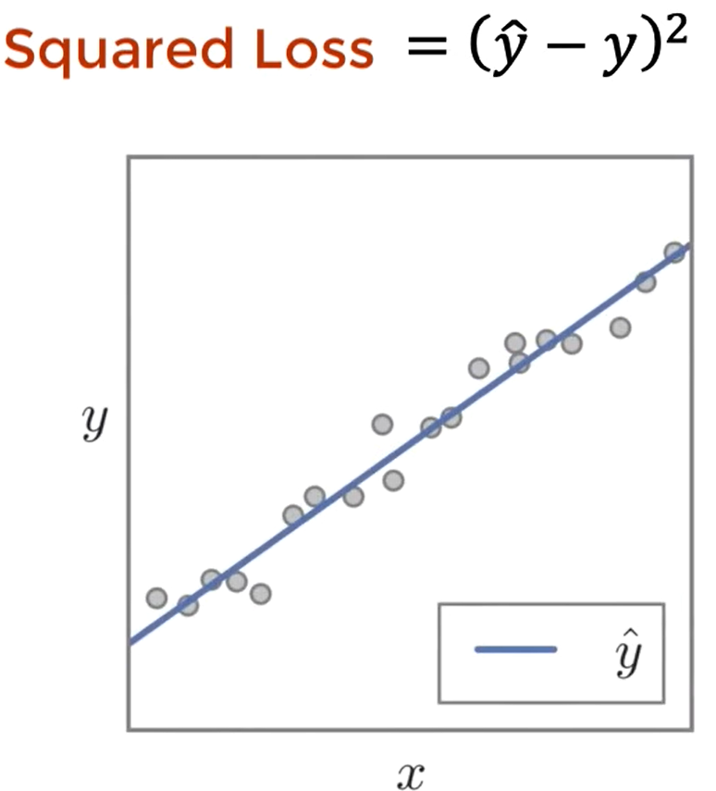
Example – Regression Squared Loss

Slide 4
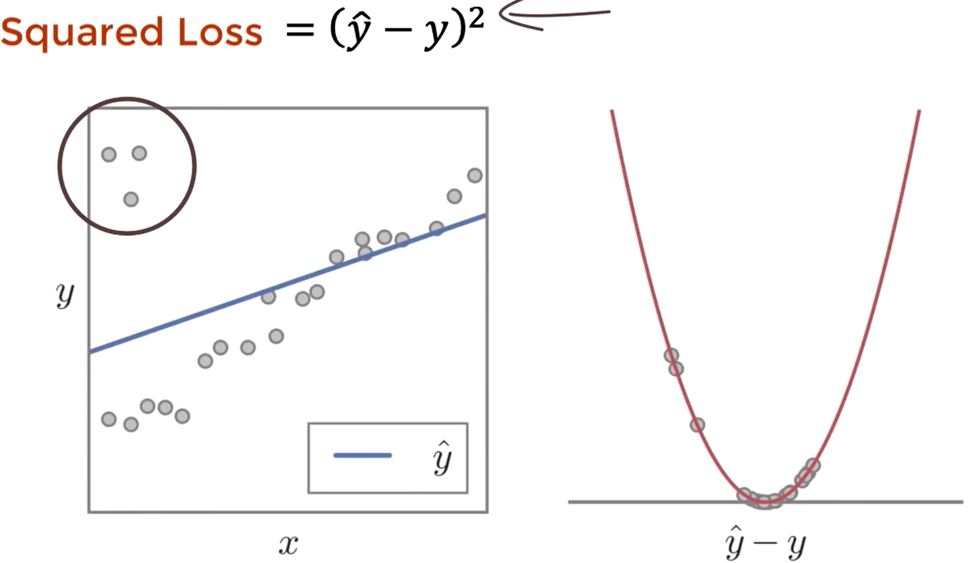

Example – Regression Squared Loss

Slide 5
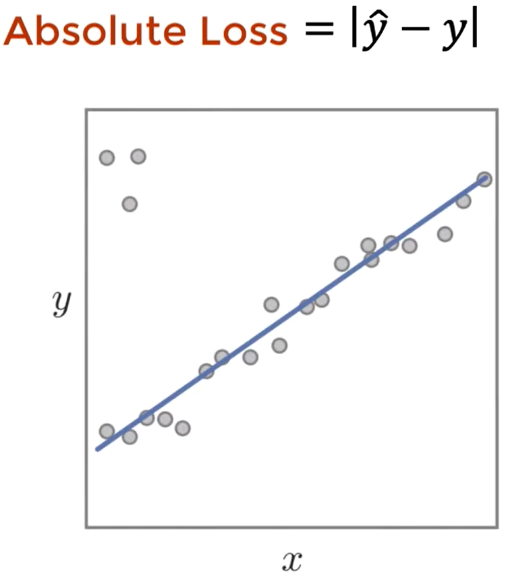
Example – Regression Absolute Loss

Slide 6
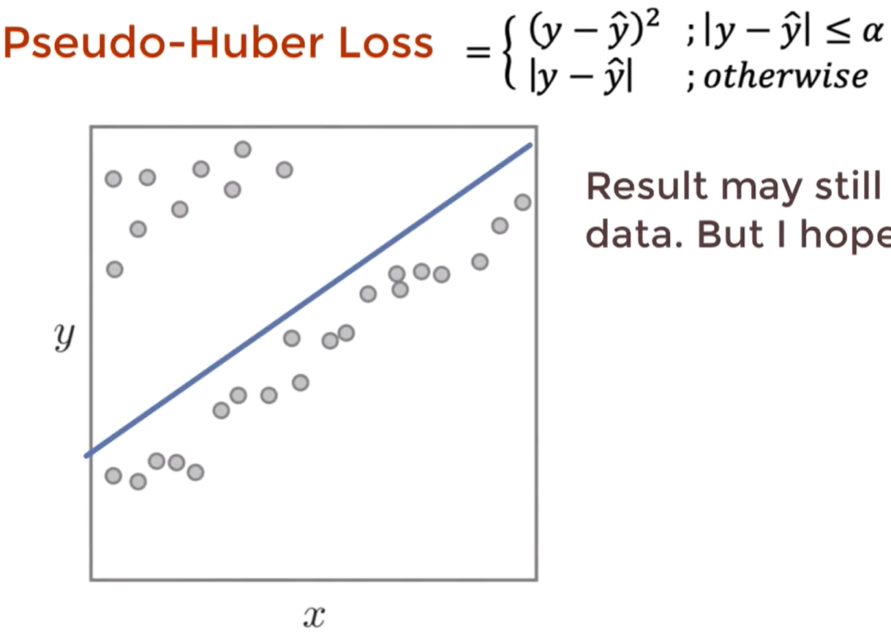

Example – Regression Pseudo-Huber Loss

Slide 7
List of loss functions and areas of application
Classification
  Cross Entropy Loss
  KL Divergence
  Hinge Loss
Regression
  Squared Loss
  Absolute Loss
  Pseudo-Huber Loss

Slide 8
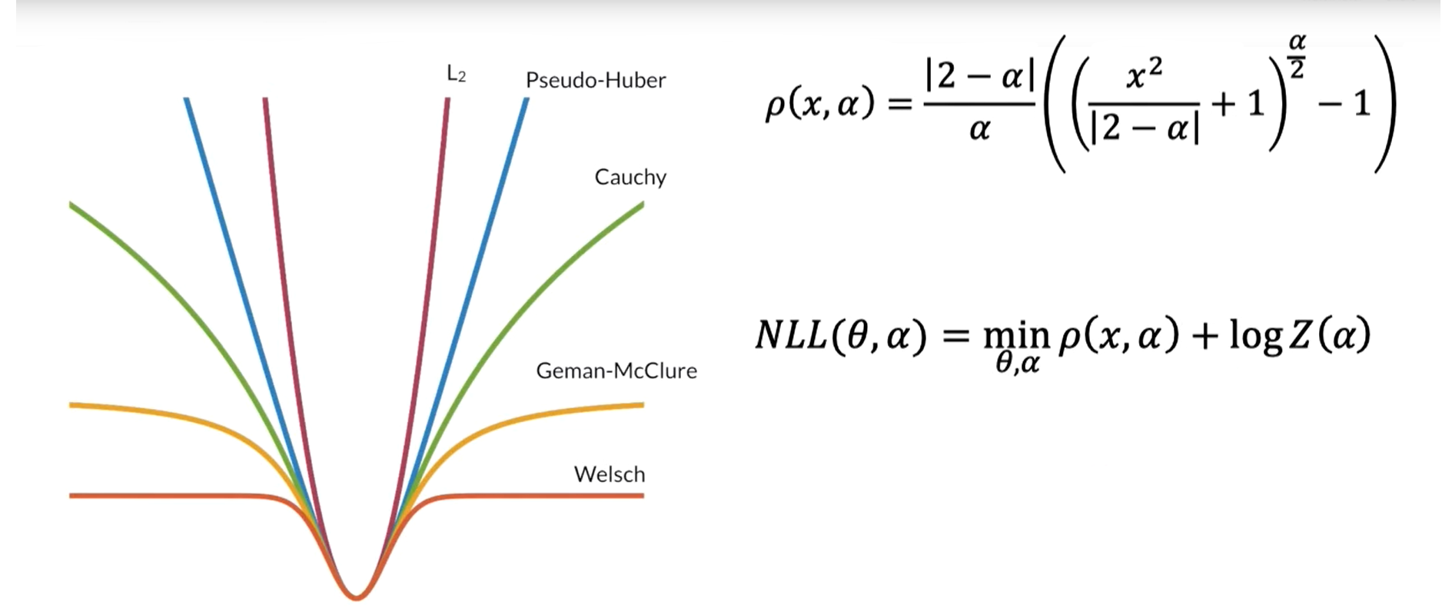
Generalized Loss Function

Slide 9
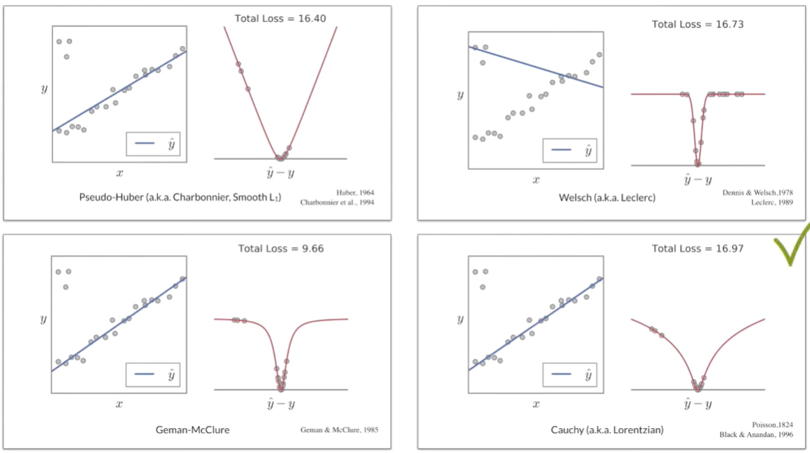

Sum-Up Example

Slide 10
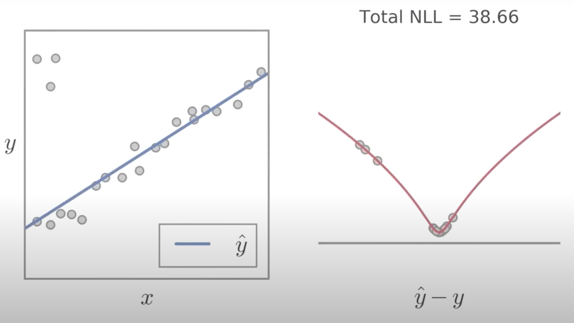
Adaptive Loss

Slide 11
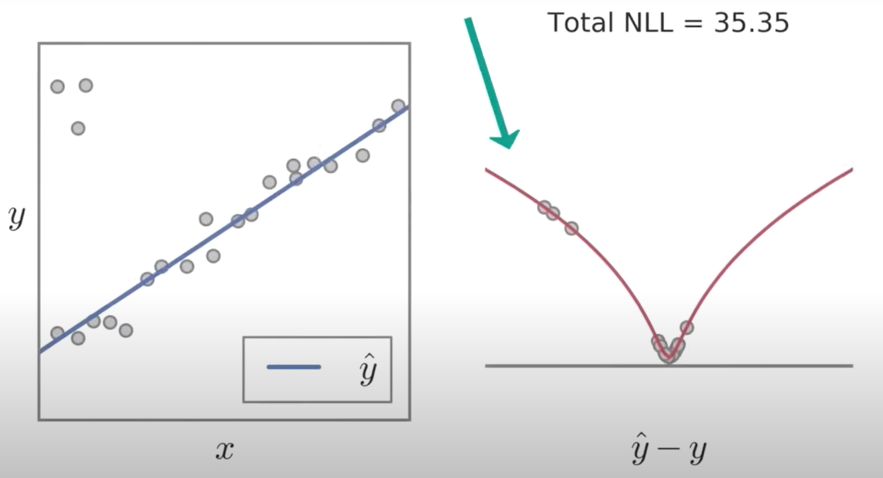

Adaptive Loss

Slide 12
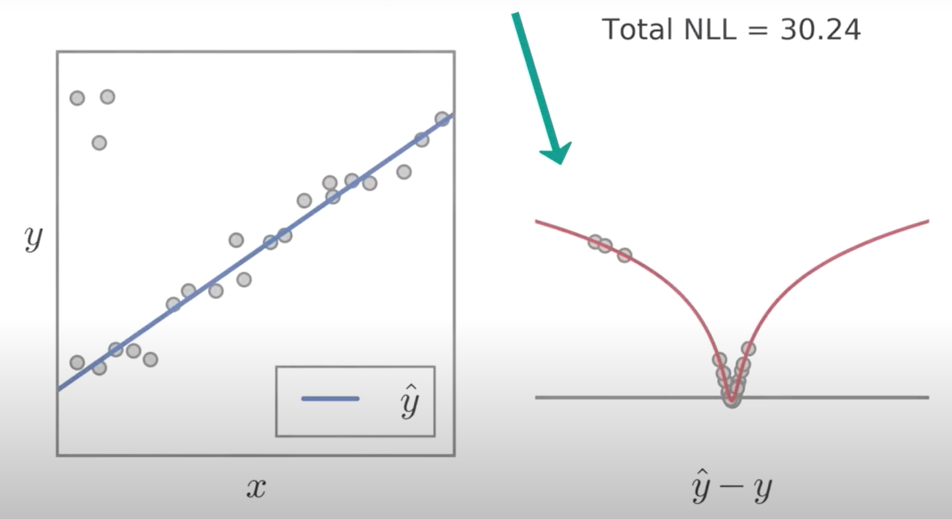

Adaptive Loss

Slide 13
Sources
https://www.youtube.com/watch?v=QBbC3Cjsnjg&t=30s
https://towardsdatascience.com/importance-of-loss-function-in-machine-learning-eddaaec69519

